Slide 1

Disease Prediction Using Machine Learning

Slide 2
Introduction
Healthcare professionals often rely on various diagnostic tests and biomarkers to assess an individual’s health status and diagnose diseases. In this scenario, we have access to a dataset containing multiple health-related attributes such as cholesterol levels, blood cell counts, hormone levels, and other physiological measurements. The dataset also includes information on whether the individual has been diagnosed with a specific disease or not.

Slide 3
objectives
Develop a predictive model that can accurately classify individuals into diseased or non-diseased categories based on their health attributes.

Slide 4
Dataset’s Attributes
Cholesterol: Level of cholesterol in the blood (mg/dL)
Hemoglobin: Protein in red blood cells carrying oxygen
Platelets: Blood cells aiding in clotting
White Blood Cells (WBC): Immune system cells fighting infections
Red Blood Cells (RBC): Cells carrying oxygen
Hematocrit: Percentage of blood volume occupied by RBC
Mean Corpuscular Volume (MCV): Average volume of RBC
Mean Corpuscular Hemoglobin (MCH): Average amount of hemoglobin in RBC
Mean Corpuscular Hemoglobin Concentration (MCHC): Average concentration of hemoglobin in RBC
Insulin: Hormone regulating blood sugar levels
BMI (Body Mass Index): Measure of body fat based on height and weight
Systolic Blood Pressure (SBP): Pressure in arteries during heartbeats
Diastolic Blood Pressure (DBP): Pressure in arteries at rest between beats
Triglycerides: Type of fat found in blood (mg/dL)
HbA1c (Glycated Hemoglobin): Measure of average blood sugar levels over past 2-3 months
LDL (Low-Density Lipoprotein) Cholesterol: "Bad" cholesterol
HDL (High-Density Lipoprotein) Cholesterol: "Good" cholesterol
ALT (Alanine Aminotransferase): Liver enzyme
AST (Aspartate Aminotransferase): Enzyme found in liver and heart
Heart Rate: Number of heartbeats per minute (bpm)
Creatinine: Waste product produced by muscles and filtered by kidneys
Troponin: Protein released into bloodstream during heart muscle damage
C-reactive Protein (CRP): Marker of inflammation in the body
Disease: Binary indicator (1: Diseased, 0: Non-diseased)

Slide 5
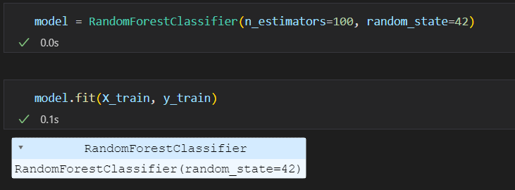
Model used
Random Forest Classifier

Slide 6
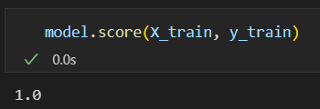
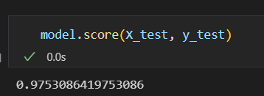
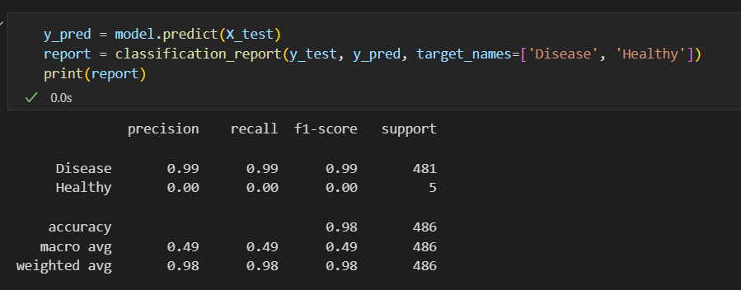
Results
Training Accuracy
Test Accuracy
Classification Report

Slide 7
Thank you

